Slide 1
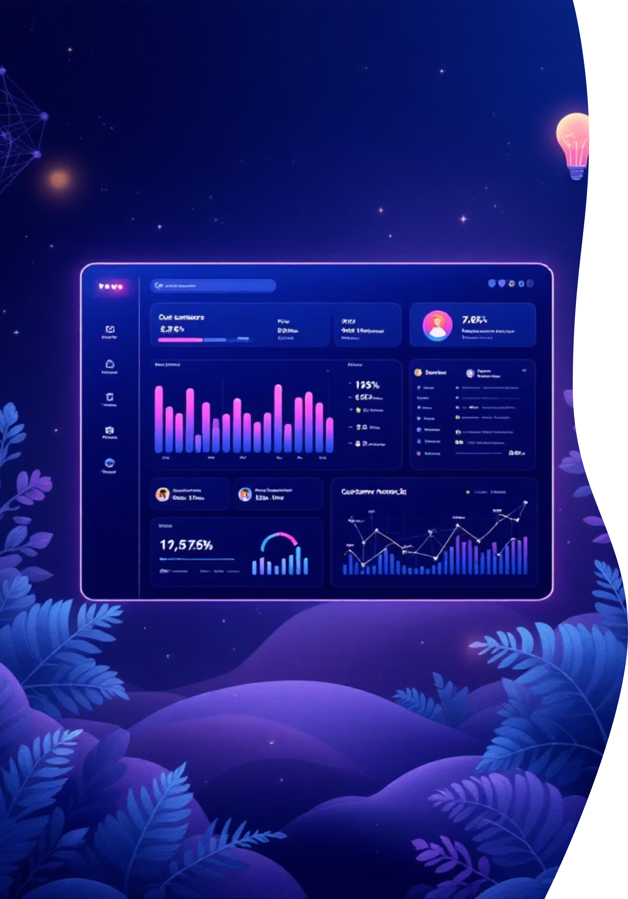
Customer Churn Analysis Report
Identifying key drivers of customer attrition and building a predictive model to proactively reduce churn — powered by machine learning and exploratory data analysis.
TELECOM DATASET · ~7,000 CUSTOMERS
PYTHON · SCIKIT-LEARN · RANDOM FOREST

Slide 2

Executive Summary
The objective of this project was to identify key factors driving customer churn and develop a predictive model to proactively reduce attrition. Using exploratory data analysis and machine learning, we built a classification model that achieved 84% accuracy in predicting churn.
84%
7K
Model Accuracy
Customers Analyzed
The analysis revealed that contract type, monthly charges, tenure, payment method, and internet service type are the strongest predictors. Customers with month-to-month contracts and high monthly charges were significantly more likely to leave.
20+
15%
Features Used
Churn Reduction Target
Implementing targeted retention strategies for high-risk customers could potentially reduce churn by 10–15%, resulting in substantial revenue preservation.

Slide 3
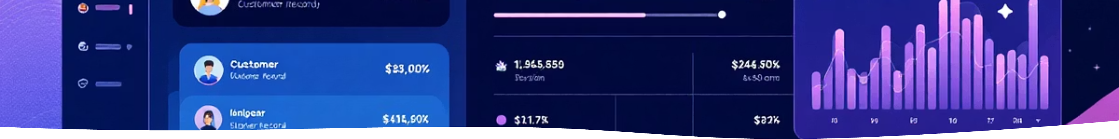
Data Overview & Preparation
Dataset Features
Data Cleaning Steps
Demographics: Gender, Senior Citizen status
Services: Internet service, Phone service
Account: Contract type, Payment method, Tenure
Financial: Monthly charges, Total charges
01
Handle Missing Values
Especially in TotalCharges column
02
Encode Categoricals
One-hot encoding for categorical variables
03
Feature Scaling
Normalize numerical variables
04
Train-Test Split
80% training / 20% testing

Slide 4
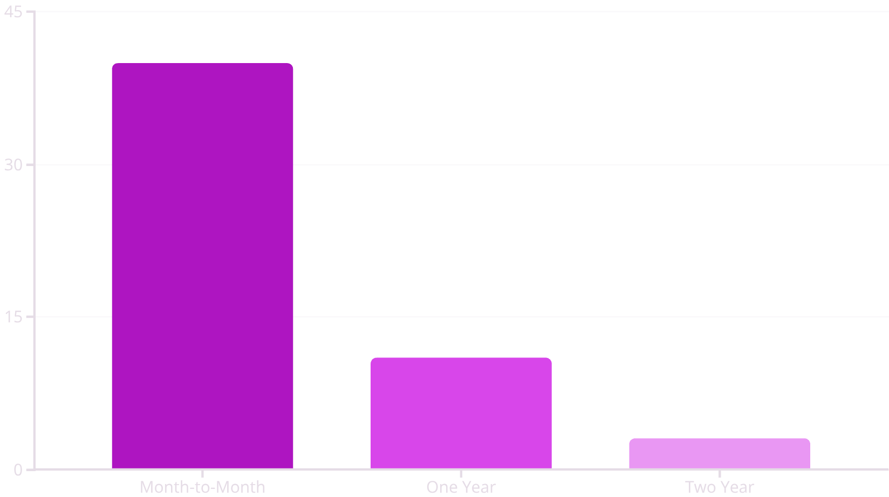
EDA Insight: Contract Type & Tenure
Contract Type Impact
Tenure Effect on Churn
Customers with tenure under 12 months show the highest churn rates. As tenure increases, churn probability steadily decreases — confirming that the early lifecycle period is the most critical window for retention intervention.
Month-to-Month: ~40% Churn
Long-Term Contracts: ~10% Churn

Slide 5
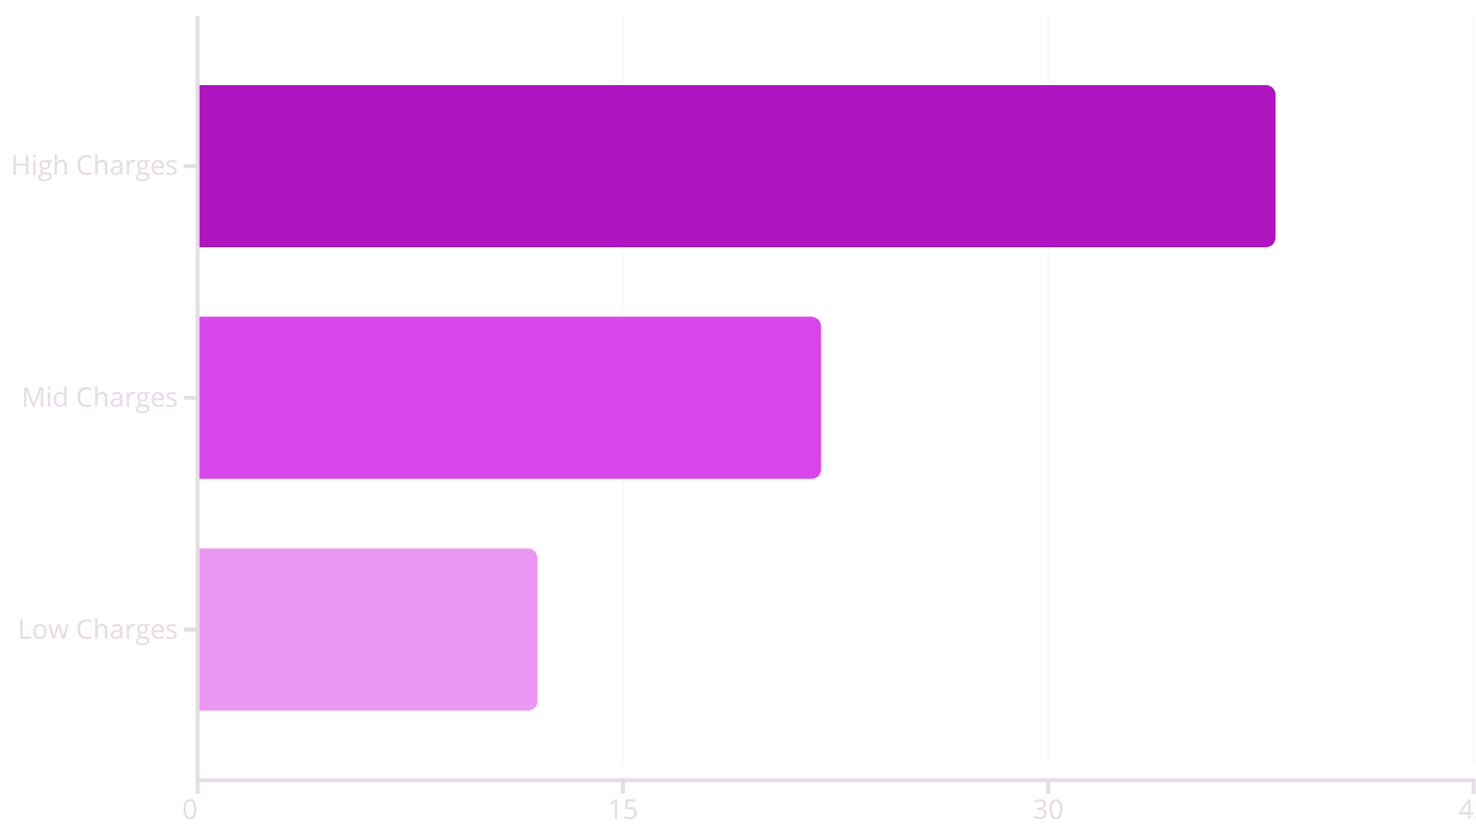
EDA Insight: Monthly Charges & Payment Method
Monthly Charges vs. Churn
Payment Method Impact
Higher monthly charges correlated positively with churn. Customers paying above-average monthly charges were significantly more likely to leave, suggesting pricing sensitivity is a major attrition driver.
Electronic Check
Auto-Payment
Highest churn rate among all payment methods
Significantly better retention outcomes
Pricing structure and contract commitment strongly influence churn behavior across all customer segments.

Slide 6





Model Approach
Feature Encoding
One-hot encoding for all categorical variables
Baseline Model
Logistic Regression as the starting benchmark
Improved Model
Random Forest for non-linear relationships
Evaluation
Accuracy, Precision, Recall, F1, Confusion Matrix

Slide 7




Best Model: Random Forest Performance
Why Random Forest Won
Random Forest outperformed Logistic Regression due to its ability to capture non-linear relationships between features — critical in a dataset with complex interactions between contract type, tenure, and charges.
84%
Key advantage: Ensemble learning aggregates multiple decision trees, reducing overfitting and improving generalization on unseen customer data.
Accuracy
Overall correct predictions
81%
Precision
True positive rate among predicted churners
78%
Recall
Actual churners correctly identified
79%
F1 Score
Harmonic mean of precision and recall

Slide 8
Top 5 Churn Drivers
Month-to-Month Contract
1
~40% churn rate vs. ~10% for long-term contracts
High Monthly Charges
2
Above-average billing strongly predicts attrition
Low Tenure (<12 months)
3
Early lifecycle is the highest-risk period
Electronic Check Payment
4
Higher churn vs. auto-payment customers
Fiber Optic Internet Users
5
Elevated churn compared to other service types

Slide 9

Business Recommendations
Convert Month-to-Month Customers
Target High-Charge Customers
Early Retention Program
Introduce bundled discounts or loyalty pricing to reduce price sensitivity.
Trigger retention offers within the first 3 months of customer lifecycle.
Offer discounts for switching to annual contracts to lock in commitment.
Encourage Auto-Payment
Personalized Retention Campaign
Provide cashback incentives for customers who switch to auto-debit.
Use churn probability score >0.7 to trigger targeted, timely offers.

Slide 10
Estimated Revenue Impact & Tools
Revenue Preservation Potential
Tools & References
If churn is reduced by just 10% among high-risk customers:
Dataset: Telecom Customer Churn (Kaggle)
Language: Python (Pandas, NumPy)
ML Library: Scikit-learn
Visualization: Matplotlib, Seaborn
Environment: Jupyter Notebook
Models: Logistic Regression, Random Forest Classifier
200
₹48L
Retained Customers/Year
Annual Revenue Preserved
Estimated 150–200 customers retained annually
₹36–48 lakhs at ₹2,000/customer/month
This demonstrates strong ROI for implementing predictive retention strategies at scale.

